Slide 1
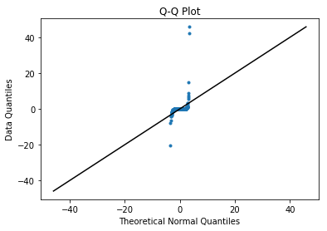
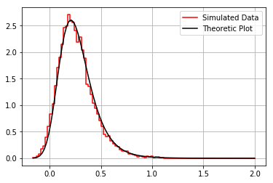
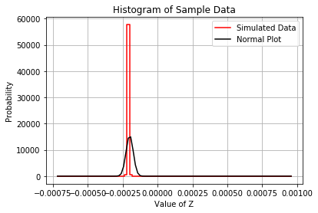
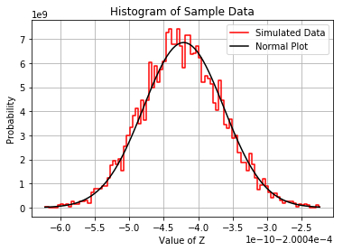
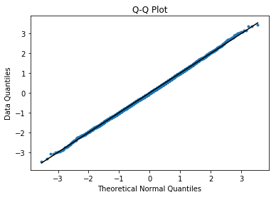
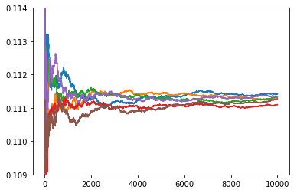
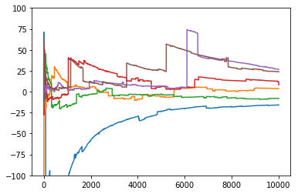


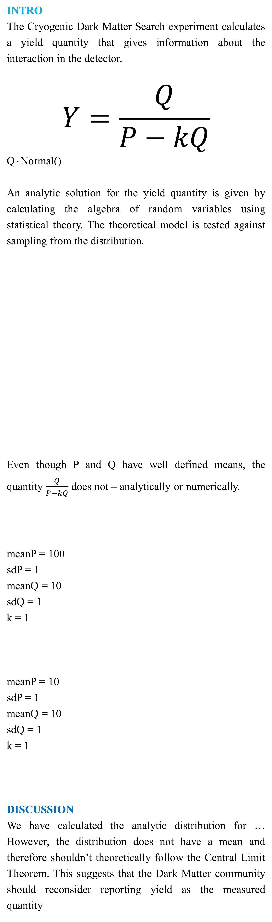
For normally distributed variables P and Q, the quantity $\frac{Q}{P−kQ}$ is analytically calculable and can behave pathologically.
Title: Mathematical Distributions for Dark Matter Detection
Non-Cognitive Predictors of Student Success: A Predictive Validity Comparison Between Domestic and International Students
The resultant distribution of yield is numerically tested against the CLT using sampling with the given parameters.
DISCUSSION (Continued)
Preliminarily, in simulation the distribution seems to follow the CLT under certain parametrization, however, this phenomena can be explained with truncated evaluation.
RESULTS
Simulated Data follows the theoretical plot closely for all inputs (one example follows).
A mean and variance cannot exist for the theoretical yield
With certain parameters the distribution clearly doesn’t follow the CLT; however, this isn’t as clear with different parameters.
ADDITIONAL TESTS
The data shouldn’t theoretically follow the CLT, and this is illustrated clearly for most choices of parameters. The following plots show an example of where the CLT is not followed using a histogram and Q-Q plot.
With simulated data (of a finite sample size), there seems to be certain parametrizations in which the distribution follows the CLT.
This, however, is an artifact of the fact that there is a very small probability that the denominator of the ratio goes to zero. Because this model of yield uses normal variables, there is always a non-zero probability of being arbitrarily close to 0. This results in the fact that the distribution can never follow the CLT. If the desired result is that the ratio distribution follows the CLT, then a method of allowing this and having an accurate ratio distribution is truncation. The truncation can either limit the denominator of the ratio to not approach 0 or the resultant ratio distribution for outliers.
Arvind Srinivasan
INTRO
The Cryogenic Dark Matter Search experiment calculates a yield quantity that gives information about the interaction in the detector.
$$Y=\frac{Q}{P−kQ}$$
Q~Normal()
An analytic solution for the yield quantity is given by calculating the algebra of random variables using statistical theory. The theoretical model is tested against sampling from the distribution.
Even though P and Q have well defined means, the quantity $\frac{Q}{P−kQ}$ does not – analytically or numerically.
meanP = 100
sdP = 1
meanQ = 10
sdQ = 1
k = 1
meanP = 10
sdP = 1
meanQ = 10
sdQ = 1
k = 1
DISCUSSION
We have calculated the analytic distribution for … However, the distribution does not have a mean and therefore shouldn’t theoretically follow the Central Limit Theorem. This suggests that the Dark Matter community should reconsider reporting yield as the measured quantity
Probability
Yield
Running Mean
Sample Size
Running Mean
Sample Size
Notes:
Notes:
In Powerpoint, click View > Guides
Keep text within gutter guides.
Author list: Don’t split names onto two lines (e.g., “Jimmy [break] Smith”). If that happens, use a new line, unless you need the space. Bold the first names of anybody who’s presenting in person.
Intro/methods/result: Do not drop below font size 28, but if you have extra space, jack up the font size until the space is full.
Do not use color in the sidebars except in graphs/figures. It’ll pull attention from the center and slow interpretation for passersby.

